Slide 1
Mayo Clinic Java Application
Team 18
Matthew Sarantos
Sharon Bradford
Alexis Montiel
Loren Benally

Slide 2
Overview
What are the requirements?
Allow patient user to login to patient profile or allow doctor user to login to doctor profile.
Allow patient to submit their symptoms/how they feel to their respective doctor.
Doctor is allowed to view their respective patients symptoms and status and provide feedback.
Feedback from doctor can include a text or contacting emergency services depending on the severity.

Slide 3
Overview
Used Eclipse for most of the coding of the GUI and to implement application features.
Used VioletUML to create all diagrams.
Used the Waterfall model
Allowed more time to focus on the requirements of the project before diving into the creation of UI and code.

Slide 4
Overview
We used a random team paradigm, but we also had a group leader (Matthew). In other words, a Self Directed Team.
Allowed for the team to work on the project individually and as a team when needed.
Allowed for the project to progress at any given time.
Flexible for everyone’s own schedule.

Slide 5
Phase 1 –Introduction
Questions at first meeting
What language to code in:
Java using Eclipse environment
Chose team leader and team Name
Matthew Sarantos
Brainstorm basic requirements
Basis for SRS document
Think of basic user interface
Decide between basic console window or GUI

Slide 6
Phase 1 –SRS
Goal and objectives
The goal of this project is to make an efferent patient care system in which doctor and patients can interact with each other.
The objective for this project is to make the system easy to use for a diverse group of patients or doctors. Whether the patients be in any sort of pain, no matter how severe.

Slide 7
Phase 1 –SRS
Statement of scope
Each patient and doctor are provided an account for the application.
Once the account has been given, the user can log into his or her account, submit a request for emergency services as a patient, submit symptoms as a patient, view patients symptoms as a doctor, submit a request for emergency services as a doctor for a patient.

Slide 8
Phase 1 –SRS
Primary function – Give patients a personal means of communication with their Doctor
Collects patient symptom data and stores it.
Gives the doctor the patients symptoms.
Lets the doctor recommend medicine or contact an ambulance.
Inputs
Patient data
Outputs
Medicine recommendations
Contacts ambulance

Slide 9
Phase 1 –SRS
Login function
The first screen will prompt the user, whether it is a Doctor or a Patient, to login.
Login information is pre-assigned and distributed via the Health Care Provider of the Patient.

Slide 10
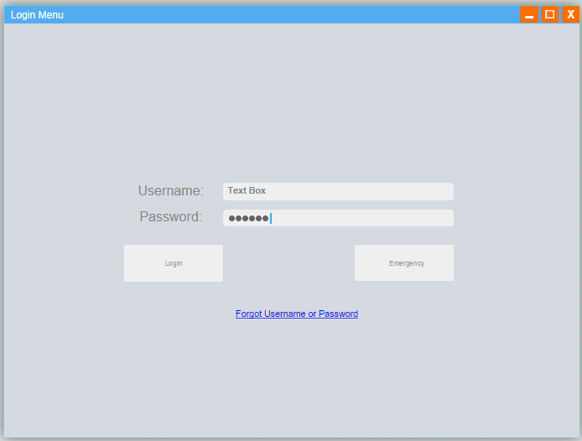
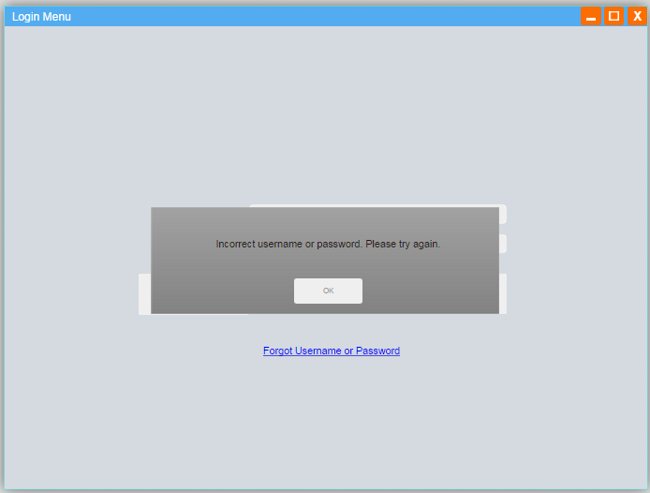
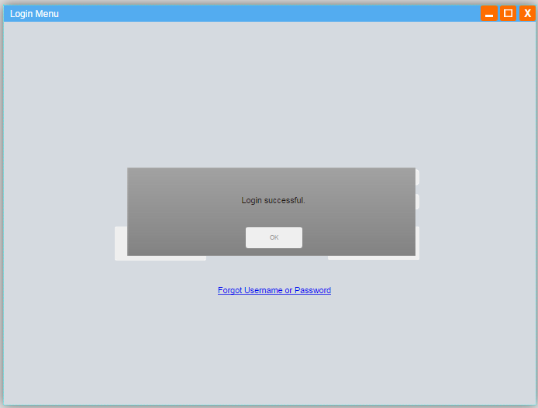
Phase 1 –Login UI
“Login” is the first screen of the program
Typing in the wrong username and/or password will prompt an error.
Typing correct information will prompt a “Login successful.” popup.

Slide 11
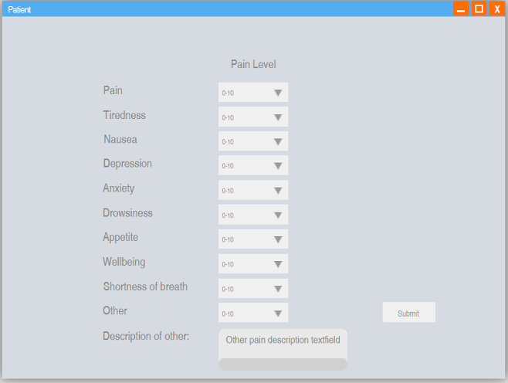
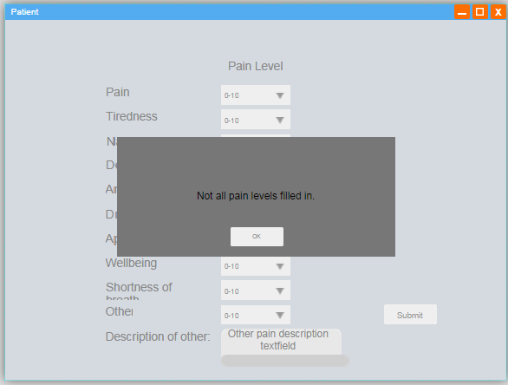
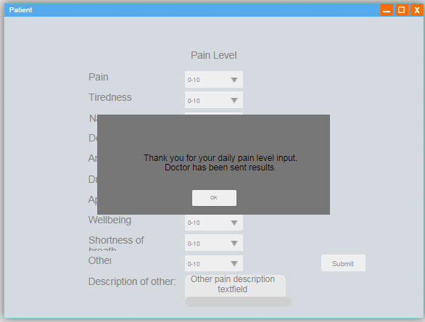
Phase 1 –Patient UI
Patient selects from the drop down text to enter symptoms.
Error pop-up if all symptoms are not filled in.
Patient informed that data is sent to doctor.

Slide 12
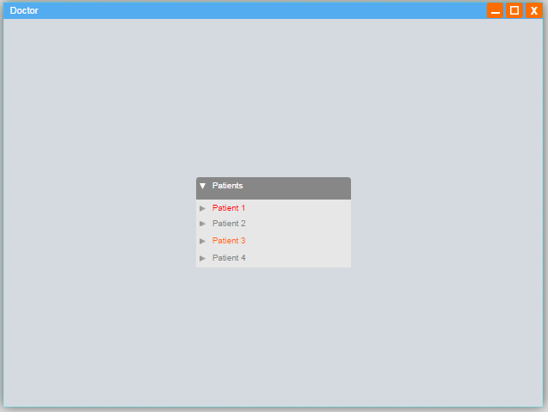
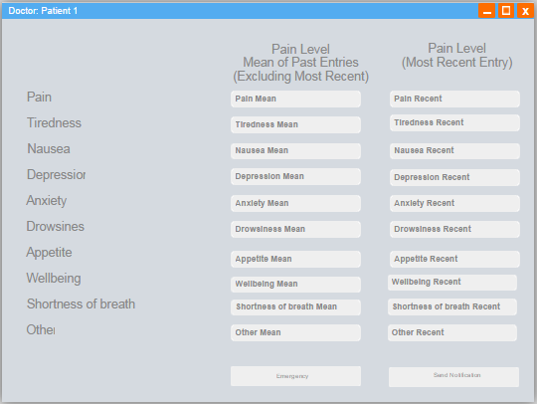
Phase 1 –Doctor UI
Doctor can chose which patient profile they want to view.
Doctor can view the symptoms of that patient. They also have the option to contact an ambulance or send a notification to their patient.

Slide 13
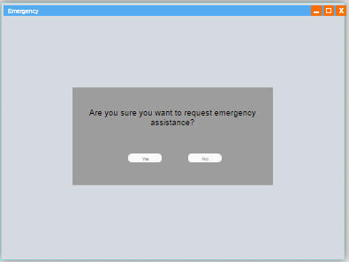
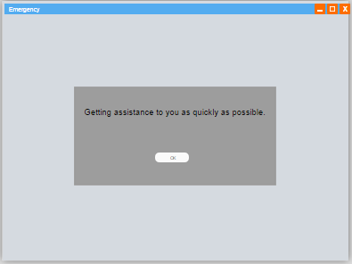
Phase 1 –Emergency
This button can be used by either the Doctor or Patient to get an ambulance.
Contact emergency confirmation.
Let’s user know emergency is on the way.

Slide 14
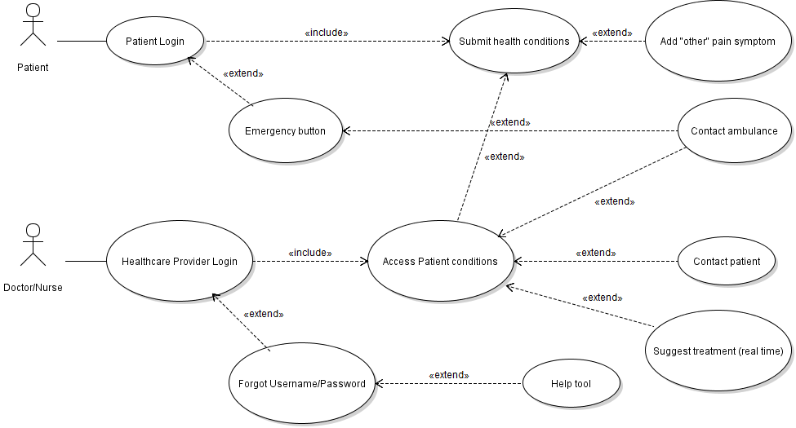
Phase 1 –Use Case Diagram

Slide 15
Phase 2
Identify development risks
All team members live off campus
Conflicting schedules for all team members
Not all members have the right skill sets
Make UML Class Diagram
Make user stories and identify Classes
Submit advice to patient, Help button use, Emergency button use, Enter patient data use, and View patient pain use.

Slide 16
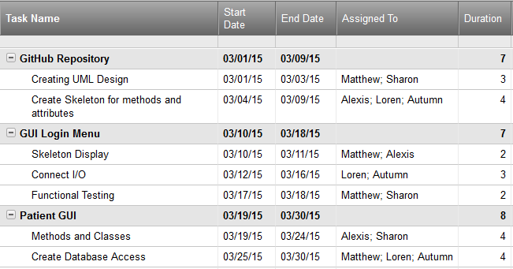
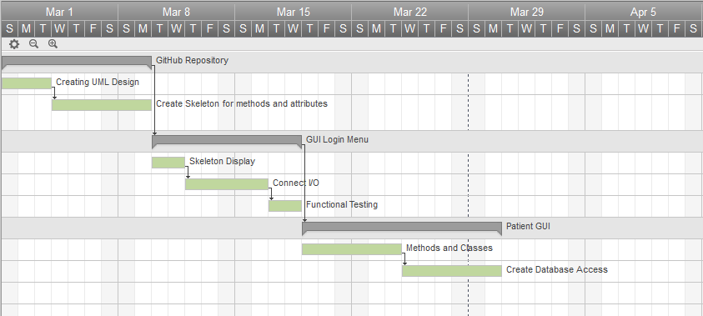
Phase 2 –Scheduling
Schedule with member names and the duration each task should take.
Task timeline that also shows dependencies.

Slide 17
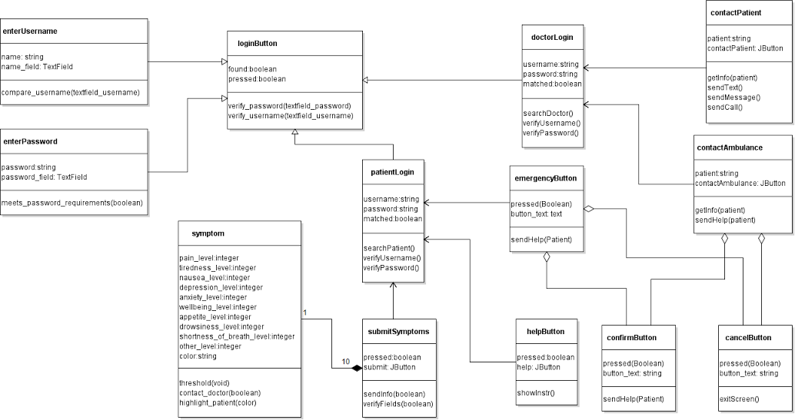
Phase 2 –UML Class Diagram

Slide 18
Phase 2 –User stories
Each member had to work on a user story and create the use case, activity diagram, and test case.
The 5 cases we used are: Enter pain data, Viewing patient pain data, Doctor submits advice to patient, Help button, and Emergency button.
We will outline one main example: “Enter pain data” story.

Slide 19
Phase 2 –Use case Scenario
After the patient has logged in with their correct credentials, the patient must chose the levels of their pain symptoms. They also are given the option to send a note to their doctor about a symptom if needed. After verifying the entered data is correct, the patient can confirm sending. A window will pop-up authorizing that “Information Sent”.

Slide 20
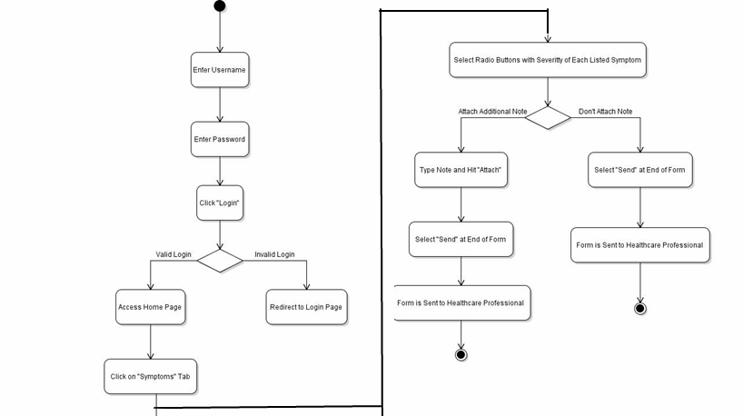
Phase 2 –Activity Diagram

Slide 21
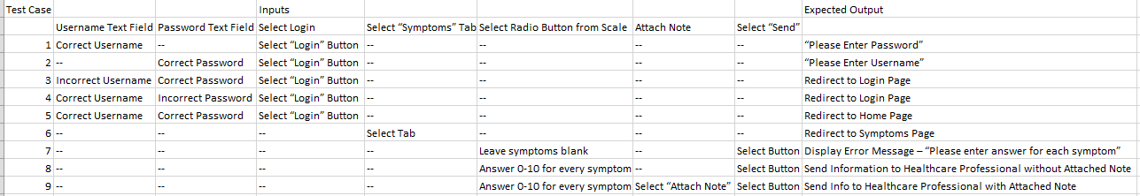
Phase 2 –Test case
The last part of the user stories was creating the test case. This table shows the Inputs and Expected Outputs of the “Enter pain data” story.

Slide 22
Phase 3-Programming
Split work into two tasks
Code Classes and Methods
Design GUI
Integrate both tasks
Done by all members
Testing
Follow phase 2 testing strategy

Slide 23
Phase 3 – Implementation
Where we are at
How we started
Progress made
What’s left to do
Feedback about implementation
Eclipse

Slide 24
Phase 3 – Testing
Still in the programming phase
Unit Testing
Login function
Add function
TreeMap
Incremental approach

Slide 25
Conclusion
What we learned
Defining requirements from a customer
Previous course assignments were outlined very specifically
In this course we had to come up with what we thought was important
How to use several tools to plan and perform project
Git Hub, Eclipse, Violet UML
How to work as a team
It is not always better to code individually because integrating the codes could take longer
Meetings and communication are essential to success
Project helped better understand class content
Sequence diagrams, Class diagrams, Use Case

Slide 26
Conclusion
Team work is a great asset
Even though meeting up in person was a difficult task, most of the work was completed when we collaborated.
About 70% done with project
On time according to the basic requirement schedule
Possibly late if including all the extra credit
Recommendations
Work early as possible so team can polish final product.
Work to everyone’s strengths.
Communication and leadership were very important in completing the project on time.

